Slide 1


Slide 2
User Interface Design

Slide 3
What is Interface?
A shared boundary across which information is passed. A hardware or software component that connects two or more other components for the purpose of passing information from one to another.
www.y2k.gov/got.html

Slide 4
What is Interface? Contd.
A linkage, usually between a computer and a user, or among computer programs. An interface between a computer and user refers to the elements of the computer and software that the user interacts with--the screens, icons, menus, and dialogues. An interface among computer programs involves using agreed-upon commands and statements that let one computer program exchange information with the other in a way that the first program can integrate the second's.
www.vnulearning.com/kmwp/glossary.html

Slide 5
What is User Interface?
the way the user tells the software what to do and how the computer displays information and options to the user.
www.jegsworks.com/Lessons/reference/glossary-u.htm

Slide 6
Explanation
The junction between a user and a computer program.
An interface is a set of commands or menus through which a user communicates with a program.
A command-driven interface is one in which you enter commands.
A menu-driven interface is one in which you select command choices from various menus displayed on the screen.
The user interface is one of the most important parts of any program because it determines how easily you can make the program do what you want.
Graphical user interfaces (GUIs) that use icons, pop-up menus and the mouse have become the standard on personal computers.
www.c-latitude.com/glossary.asp

Slide 7
User interface design
User interface design creates an effective communication medium between a human and a computer.
Following a set of interface design principles, design identifies interface objects and actions and then creates a screen layout that forms the basis for a user interface prototype

Slide 8

Areas of Concern
The design of interfaces between software components
The design of interfaces between the software and other nonhuman producers and consumers of information (i.e. other external entities)
The design of the interface between a human (i.e. the user) and the computer.

Slide 9
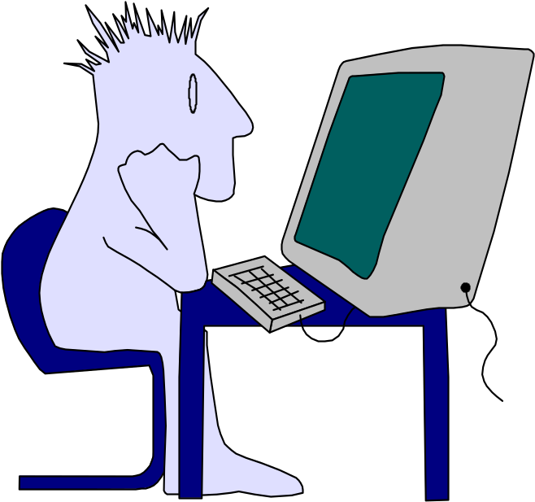
Interface Design
Easy to use?
Easy to understand?
Easy to learn?

Slide 10
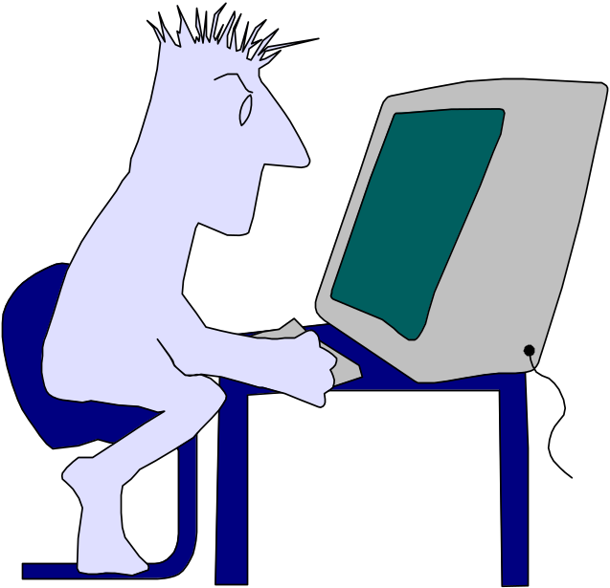
Interface Design
Typical Design Errors
lack of consistency
too much memorization
no guidance / help
no context sensitivity
poor response
Arcane/unfriendly

Slide 11
Steps
Identification of
User, task,
Environmental requirements
Creation and Analysis
of User scenarios
Creation of
screen layout

Slide 12
Steps (contd.)
Prototype
Implement the
Design model

Slide 13
A user interface is well-designed when the program behaves exactly how the user thought it would.

Slide 14
Why is it Important…?
You won’t like your software, if
  It is difficult to use
  It forces you into mistakes
  It frustrates your efforts to accomplish your goals
You wont like it regardless of the computational power it exhibits
or the functionality it offers
Because it molds a user’s
perception of the software, the interface has to be right

Slide 15
Golden Rules
Place the user in control
Reduce the user’s memory load
Make the interface consistent

Slide 16
Place the User in Control
Define interaction modes in a way that does not force a user into unnecessary or undesired actions.
Provide for flexible interaction.
Allow user interaction to be interruptible and undoable.
Streamline interaction as skill levels advance and allow the interaction to be customized.
Hide technical internals from the casual user.
Design for direct interaction with objects that appear on the screen.

Slide 17
Reduce the User’s Memory Load
Reduce demand on short-term memory.
Establish meaningful defaults.
Define shortcuts that are intuitive.
The visual layout of the interface should be based on a real world metaphor.
Disclose information in a progressive fashion.

Slide 18
Make the Interface Consistent
Allow the user to put the current task into a meaningful context.
Maintain consistency across a family of applications.
If past interactive models have created user expectations, do not make changes unless there is a compelling reason to do so.

Slide 19
User Interface Design Models
Design model — data, architectural, interface and procedural representations of the software
User model — a profile of all end users of the system
System perception — the user’s mental image of what the interface is
System image — the “presentation” of the system projected by the complete interface

Slide 20
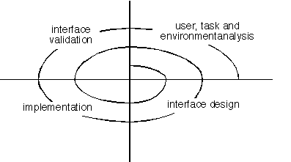
User Interface Design Process

Slide 21
Interface Design Activities
1. Establish the goals and intentions for each task.
2. Map each goal/intention to a sequence of specific actions.
Specify the action sequence of tasks and subtasks, also called a user scenario, as it will be executed at the interface level.
Indicate the state of the system, i.e., what does the interface look like at the time that a user scenario is performed?
5. Define control mechanisms, i.e., the objects and actions available to the user to alter the system state.
6. Show how control mechanisms affect the state of the system.
7. Indicate how the user interprets the state of the system from information provided through the interface.

Slide 22
Common Design Issues
System response time
User help facilities
Error information handling
Command labeling

Slide 23
References:
Software Engineering - A practitioner’ s Approach by Roger S. Pressman (7th Ed)
  12.1, 12.2, 12.4
Software Engineering - A practitioner’ s Approach by Roger S. Pressman (5th Ed)
  Chapter 15
    15.1 - (15.1.1, 15.1.2, 15.1.3)
    15.2 - (15.2.1, 15.2.2)
    15.4.2

